Slide 1

Walk @ Work Step Count Challenge
Rack up steps, walk your way to health, & win a prize!

Slide 2
4-Week Challenge begins July 9th – Aug. 5th
Deadline to Register: Friday, July 13th
Walking is a gentle activity that you can do at your own pace
Done regularly, walking can strengthen your heart and lungs, improve circulation and help to maintain a healthy weight
Walking also tones your muscles and keeps your bones strong

Slide 3
Where to begin? Best Apps for Counting Steps

Slide 4
Activities to Boost Your Step Count
Take public transportation or park far away.
Drinking more water means more frequent trips to restroom as well as trips to the water cooler for a refill.
Walk over to the farthest facilities from your desk.
Try a walking meeting instead of the usual conference room. Fresh air & extra movement can be refreshing and boost creativity for the rest of the day.
Go for a lunch walk.
Walk over to talk to your co-workers
Take the stairs whenever possible
Set an alarm on your phone for every hour to walk for 10 minutes.
Get up and walk during commercials while watching t.v.
Go for a post-dinner walk around the neighborhood.

Slide 5
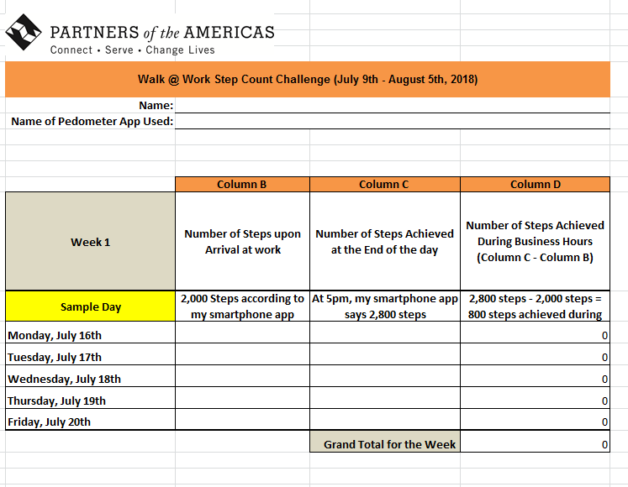
Logging & Submitting Your Steps
1. Fill out Daily Walking Log
2. Submit by email or in box near elevator at the end of the day on Fridays

Slide 6



Winners Announcement @ Next Staff Meeting
Gift cards and other prizes will be given to:
Top 3 Individuals that walked the most steps
Top Unit/Department that walked the most steps

